Slide 1
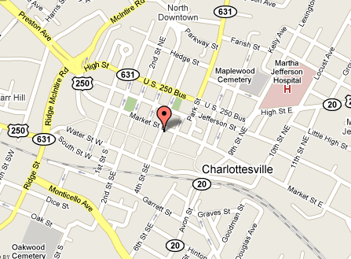
Build Your Own Salad
About Us
We are a family owned and operated, full service grocery store located in the heart of downtown Charlottesville. We carry over 6,000 products—so there’s something for everybody. In addition to the common fare, we have gluten-free items, local produce and products, and an extensive beer and wine selection. Our deli offers Boar’s Head® Meats and our own house roasted meats that you’ll find in our delicious made-to-order sandwiches. We also offer catering and delivery for all of our deli menu items. We are open seven days a week and would love to fill all of your grocery needs. In fact, if you want something we don’t have, let us know and we’ll order it for you! At Market Street Market you will find big supermarket products and prices in a friendly, neighborhood grocery.
Like us on Facebook to hear about our daily specials!
Small $2.99 (includes one side and one topping)
Large $3.99 (includes one side and three toppings)
Greens (Pick One)
Romaine
Iceberg
Organic Baby Greens
Organic Baby Spinach
Toppings (Extra Sides .50¢)
Blue Cheese
Feta Cheese
Roasted Red Peppers
Kalamata Olives
Peppadews
Banana Peppers
Jalapeno Slices
Avocado
Cherry Tomatoes
Sides (Extra Sides $1)
Chicken Salad
Tuna Salad
Egg Salad
Salmon Salad
Ham
Herb Roasted Turkey
Chicken Breast
Hummus
Fresh Mozzarella
Dressings (Pick One)
Oil & Vinegar Honey Mustard
Caesar Ranch
Thousand Island Balsamic
Lite Italian French
Blue Cheese
Deli Menu
Just in case you can’t find us…
4th St
www.facebook.com/marketstreetmarket
Hours
Mon.-Fri. 8:00am-9:00pm
Sat. 8:30am-9pm
Sun. 10:00am- 8:00pm
400 E. Market St
Ph: (434) 293-3478
Fax: (434) 293-3430
marketstreetmarket@gmail.com
Downtown Mall
Catering is available!
Please check our website for the catering menu:
We are located at the corner of 4th St. and Market St. We are accessible by bus routes 1, 4, 6, 7, 8, 9, 10, 11 and the Free Trolley. We also offer validation for 2 hours of free parking in the Market St. and Water St. garages.
www.MarketStreetMarket.net

Slide 2
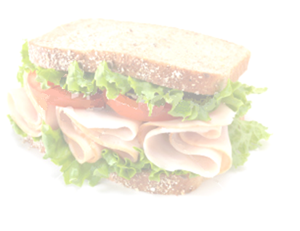
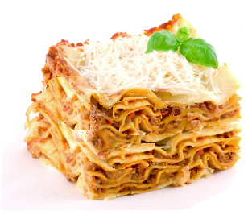
Build Your Own Sandwich
With Boar’s Head® Meats
Signature
Sandwiches
Breakfast
Daily Menu
Two Eggs any style with toast...............................................................$2.99
add bacon or ham...............................................................................................$1.00
add cheese.............................................................................................................$.50
Omelette add ham or bacon, mushrooms, onions, peppers, and/or cheese...................................................................................................................$4.50
Toasted English Muffin
with cream cheese............................................................................................$1.99
with lox and cream cheese...........................................................................$4.99
$3.99
$4.99
Prosciutto and Blue Cheese Prosciutto di Parma with crumbled blue cheese (try Asiago or Goat if you’re not a fan of blue!), sliced Bosc pear, honey, fresh basil on stirato roll brushed with extra virgin olive oil..........................................................................................................$9
House Roast Beef in-house roast beef with thin sliced red onion, fresh tomato, watercress, dill Havarti, and chipotle lime spread on stirato roll...............................................................................................................$9
Herb Oven Roasted Turkey herb infused oven roasted turkey breast with provolone cheese, watercress, tomatoes, red onion,
and paprika cream cheese spread on stirato roll.....................................$8
House Corned Beef house-made corned beef served warm with sauerkraut, Swiss cheese, and horseradish brown mustard on Jewish rye bread.......................................................................half $5 whole $9
House Pastrami hot with thin sliced sautéed onion, coleslaw,
and deli mustard on Jewish rye bread..............................half $5 whole $9
Black Forest Ham Boar’s Head black forest ham with smoked Gouda, bacon, watercress, and tomato on stirato roll...........................$7
Roasted Vegetable choices of zucchini, eggplant, carrot, parsnips, red pepper, onion, with spinach, goat cheese, and olive tapenade on stirato roll.....................................................................................$7
Fresh Mozzarella with sliced tomatoes, fresh basil, roasted red peppers, and black pepper on toasted stirato roll brushed with extra virgin olive oil.............................................................................................$8
Hummus and Portabella with spinach, roasted red pepper, sautéed onion, and balsamic vinaigrette on a whole wheat wrap....$6
Nova Smoked Salmon with herbed cream cheese, capers, and
red onions on stirato roll...................................................................................$8
Turkey
Cracked Pepper Turkey
Ham
Salami
Liverwurst
Curried Tofu Spread
Hummus
Egg Salad
House Roast Beef
House Chicken Breast
Kite’s® Country Ham
Tuna Salad
Chicken Salad
Curry Chicken Salad
Cajun Shrimp Salad
Pork BBQ
Choose Your…
In the Deli Case
Cheeses
Cheddar
Provolone
Swiss
Smoked Gouda
Dill Havarti
Pepper jack
American
Muenster
Breads
White
Wheat
Wrap
Kaiser Roll
Organic Wheat (add $.50)
Rye (add $1)
Stirato Roll (add $1)
Demi-Baguette (add $1)
Homemade Daily
Chicken Salad.............................................................................................$8.99/lb
Curry Chicken Salad...............................................................................$8.99/lb
White Albacore Tuna Salad................................................................$9.99/lb
Cajun Shrimp Salad................................................................................$12.99/lb
Salmon Salad.............................................................................................$12.99/lb
Egg Salad......................................................................................................$4.99/lb
Potato Salad...............................................................................................$5.99/lb
Tabouli.............................................................................................................$6.99/lb
Coleslaw........................................................................................................$3.99/lb
Pork BBQ.........................................................................................................$6.99/lb
Roasted Vegetables...............................................................................$8.99/lb
Curried Tofu..................................................................................................$6.99/lb
Macaroni and Cheese.................................................................................$3.50
Deviled Eggs.............................................................................................$.75 each
Spiced Cajun Chicken Wings.........................................................$.50 each
Baby Back Ribs.....................................half rack $8.99, whole rack $16.99
Toppings & Condiments
Lettuce
Tomato
Spinach
Watercress
Red Onions
Mayo
Mustard
Chipotle Spread
Oil &Vinegar
Salt & Pepper
Extras (add $1)
Avocado
Bacon
Cucumber (50¢)
Mushrooms (50¢)
Roasted Red Peppers
Tapenade
Check out our cold case for fresh
grab-and-go items made daily!
All sandwiches are made to order!

